Slide 1

Title: Student Information via QR Code
Internship Member
P. Premajyothi (323103210178)
Internship Mentor
Mrs. V S Swathi Priya
Associate Professor
CSE Department
Department of Computer Science and Engineering
GAYATRI VIDYA PARISHAD COLLEGE OF ENGINEERING FOR WOMEN(A)
[Approved by AICTE NEW DELHI, Affiliated to AU Visakhapatnam]
[Accredited by National Board of Accreditation(NBA) for B.Tech. CSE, ECE & IT – valid from 2019-22 and 2022-25]
[Accredited by National Assessment and Accreditation Council (NAAC) with A Grade – valid from 2022-27]
Kommadi, Madhurawada, Visakhapatnam – 530048
Academic Batch : 2024-25

Slide 2
Contents
Abstract
Problem Definition
Internship Project Workflow (Architectural Diagram)
Implementation
Results( Screenshots)
Conclusion
References

Slide 3
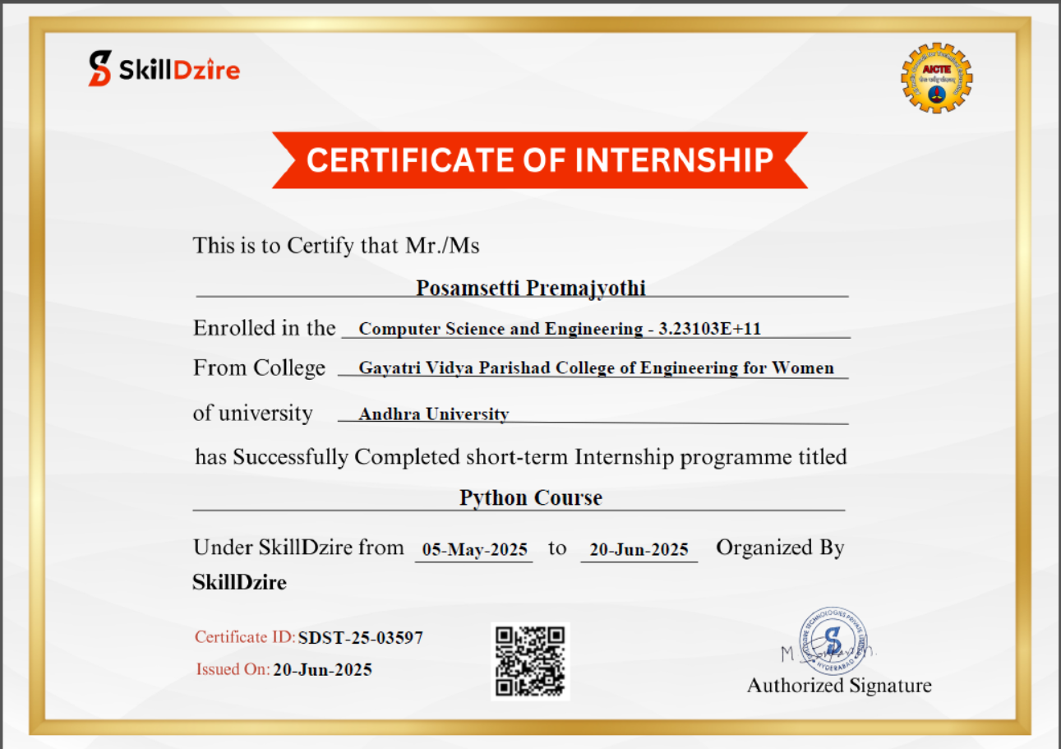
Certificate

Slide 4
ABSTRACT
This HTML, Flask, SQLite, and Python–based project implements a simple “QR Code–Based Student Information System” designed to work through a web browser. The system allows administrators to register student details such as name, roll number, department, year, and photograph through a web interface. Upon successful registration, a unique QR code is generated for each student, embedding a URL linked to their stored information.
When the QR code is scanned using a mobile device or browser, the system retrieves and displays the corresponding student details instantly. The application manages data storage using an SQLite database and handles QR code generation, file storage, and information retrieval through Flask routes. This project demonstrates a lightweight, contactless, and efficient approach for accessing student information securely within a local or network-based environment.

Slide 5
PROBLEM STATEMENT
In many educational institutions, accessing student information is still handled through manual records or traditional database searches, which can be slow and error-prone. This creates difficulties in quickly retrieving accurate student details when needed. The Student Information via QR Code project addresses this issue by generating unique QR codes for each student. By scanning the QR code, authorized users can instantly access student information through a web-based interface. This system reduces paperwork, improves efficiency, and minimizes human errors. It offers a modern, secure, and scalable solution for student data management in educational environments.

Slide 6
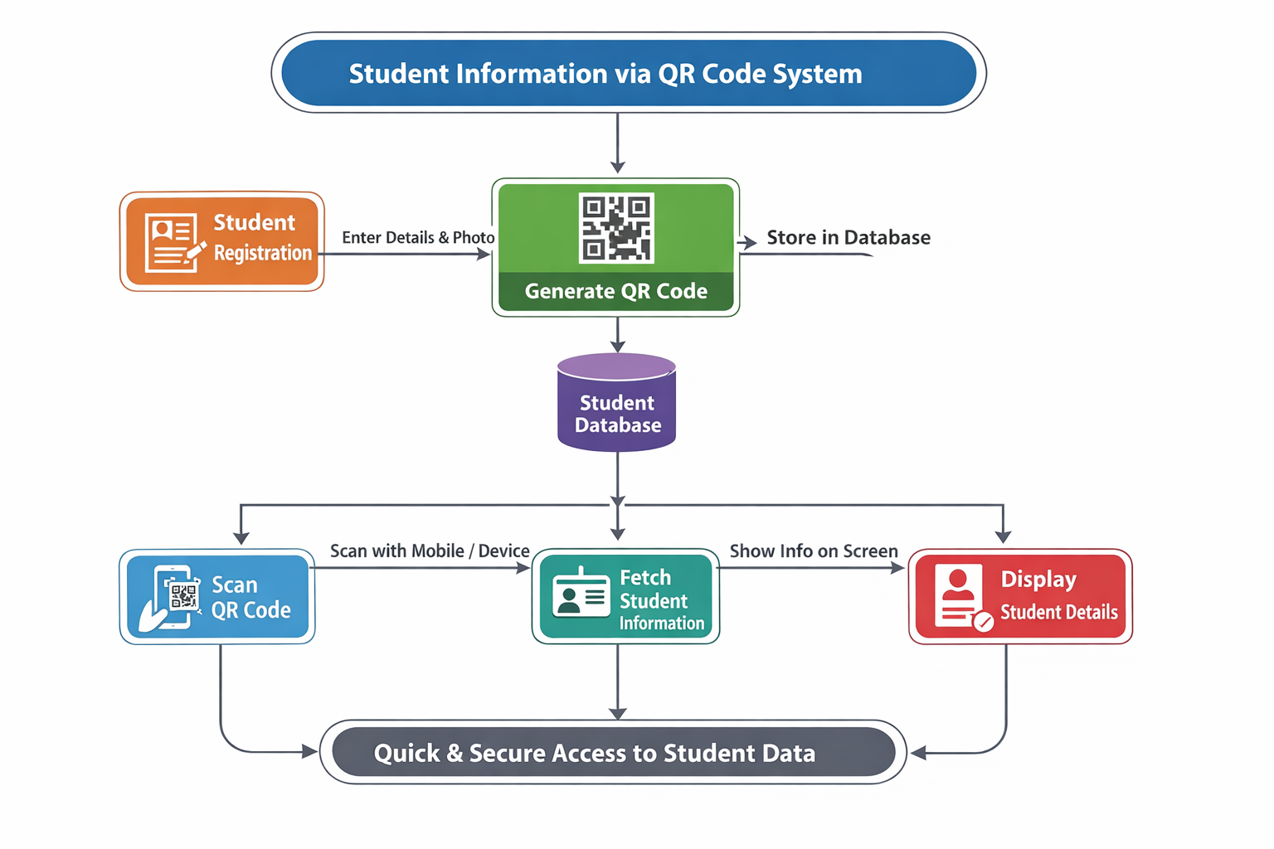
METHODOLOGY/ARCHITECTURE

Slide 7
PROPOSED METHODOLOGY CONTD..
The Student Information via QR Code project provides a simple and efficient way to access student details using QR technology. The system includes a registration interface, a database to store student information, and automatically generated QR codes linked to each student’s profile. When a QR code is scanned, the corresponding student details—such as name, roll number, department, year, and photo—are displayed instantly through a web interface. This enables quick, contactless, and accurate information retrieval. The system is easy to use, minimizes manual effort, and improves data accessibility. Future enhancements may include role-based access, security validation, cloud deployment, and integration with college management systems for wider usage.

Slide 8
IMPLEMENTATION [ CODING Files ]
The implementation begins with a structured system design that includes a student database, a QR code generation module, and a QR scanning interface. Each student’s details are stored securely in the database, and a unique QR code is generated using the student’s identification number. The scanning module reads the QR code and sends the extracted data to the server for verification. The backend logic processes the request, retrieves the corresponding student information, and displays it on the user interface. Security checks ensure that only authorized users can access the data. This organized workflow keeps the system efficient, reliable, and easy to maintain while reducing manual effort and complexity.
https://drive.google.com/file/d/11iLhkNGJcpOG42ZdOAyjWyv7gQYvvOfx/view?usp=sharing

Slide 9
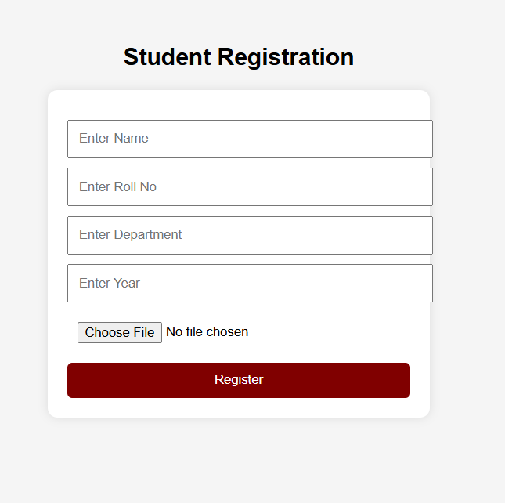
OUTPUT SCREENSHOTS

Slide 10
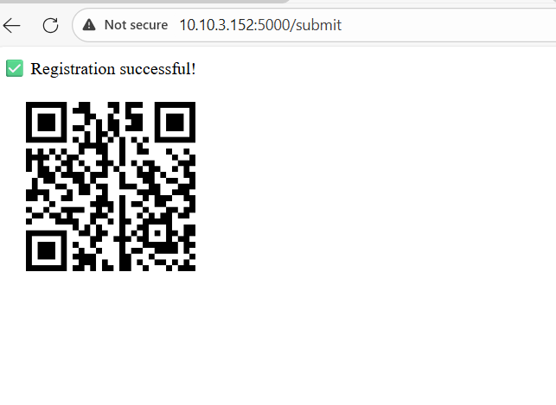
OUTPUT SCREENSHOTS

Slide 11
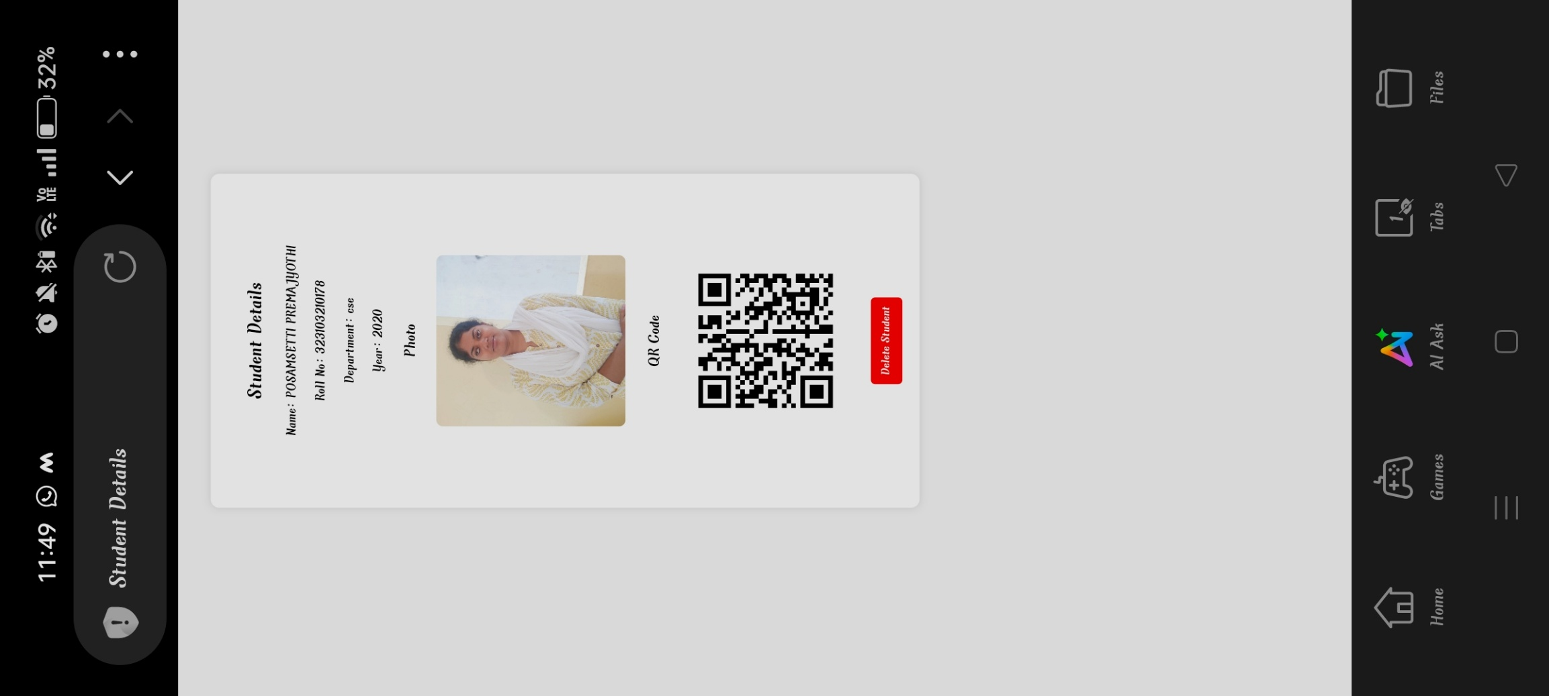
OUTPUT SCREENSHOTS

Slide 12
CONCLUSION
In conclusion, the proposed Student Information via QR Code project provides a simple, secure, and efficient solution for accessing student details using modern web technologies. The system generates a unique QR code for each student, which can be scanned to instantly retrieve relevant information from the database. This approach reduces manual work, saves time, and minimizes errors compared to traditional record-keeping methods. By integrating QR code generation, database connectivity, and user-friendly interfaces, the project ensures quick and reliable information access. Overall, this implementation demonstrates how a practical and functional student information system can be developed using minimal resources while improving accuracy, speed, and convenience in educational institutions.

Slide 13
REFERENCES
Journal Articles & Standards
QR Code Standard – ISO/IEC 18004
Research papers on QR code applications in education and identity management
Online Resources
Flask Documentation – https://flask.palletsprojects.com/
SQLite Documentation – https://www.sqlite.org/docs.html
Python QR Code Library – https://pypi.org/project/qrcode/
MDN Web Docs – https://developer.mozilla.org/ • Wikipedia: https://en.wikipedia.org/wiki/QR_code

Slide 14
Thank You Sir/Mam

